Slide 1


Better Place Project

Slide 2


Better Place is a tool, not content: gives core functions
Stray animal monitoring and summon volunteers
Bootstrap financial resources and vet help
Track finance – crowdfunding and charity
User and animal stats
san k at sankdev0@gmail.com

Slide 3
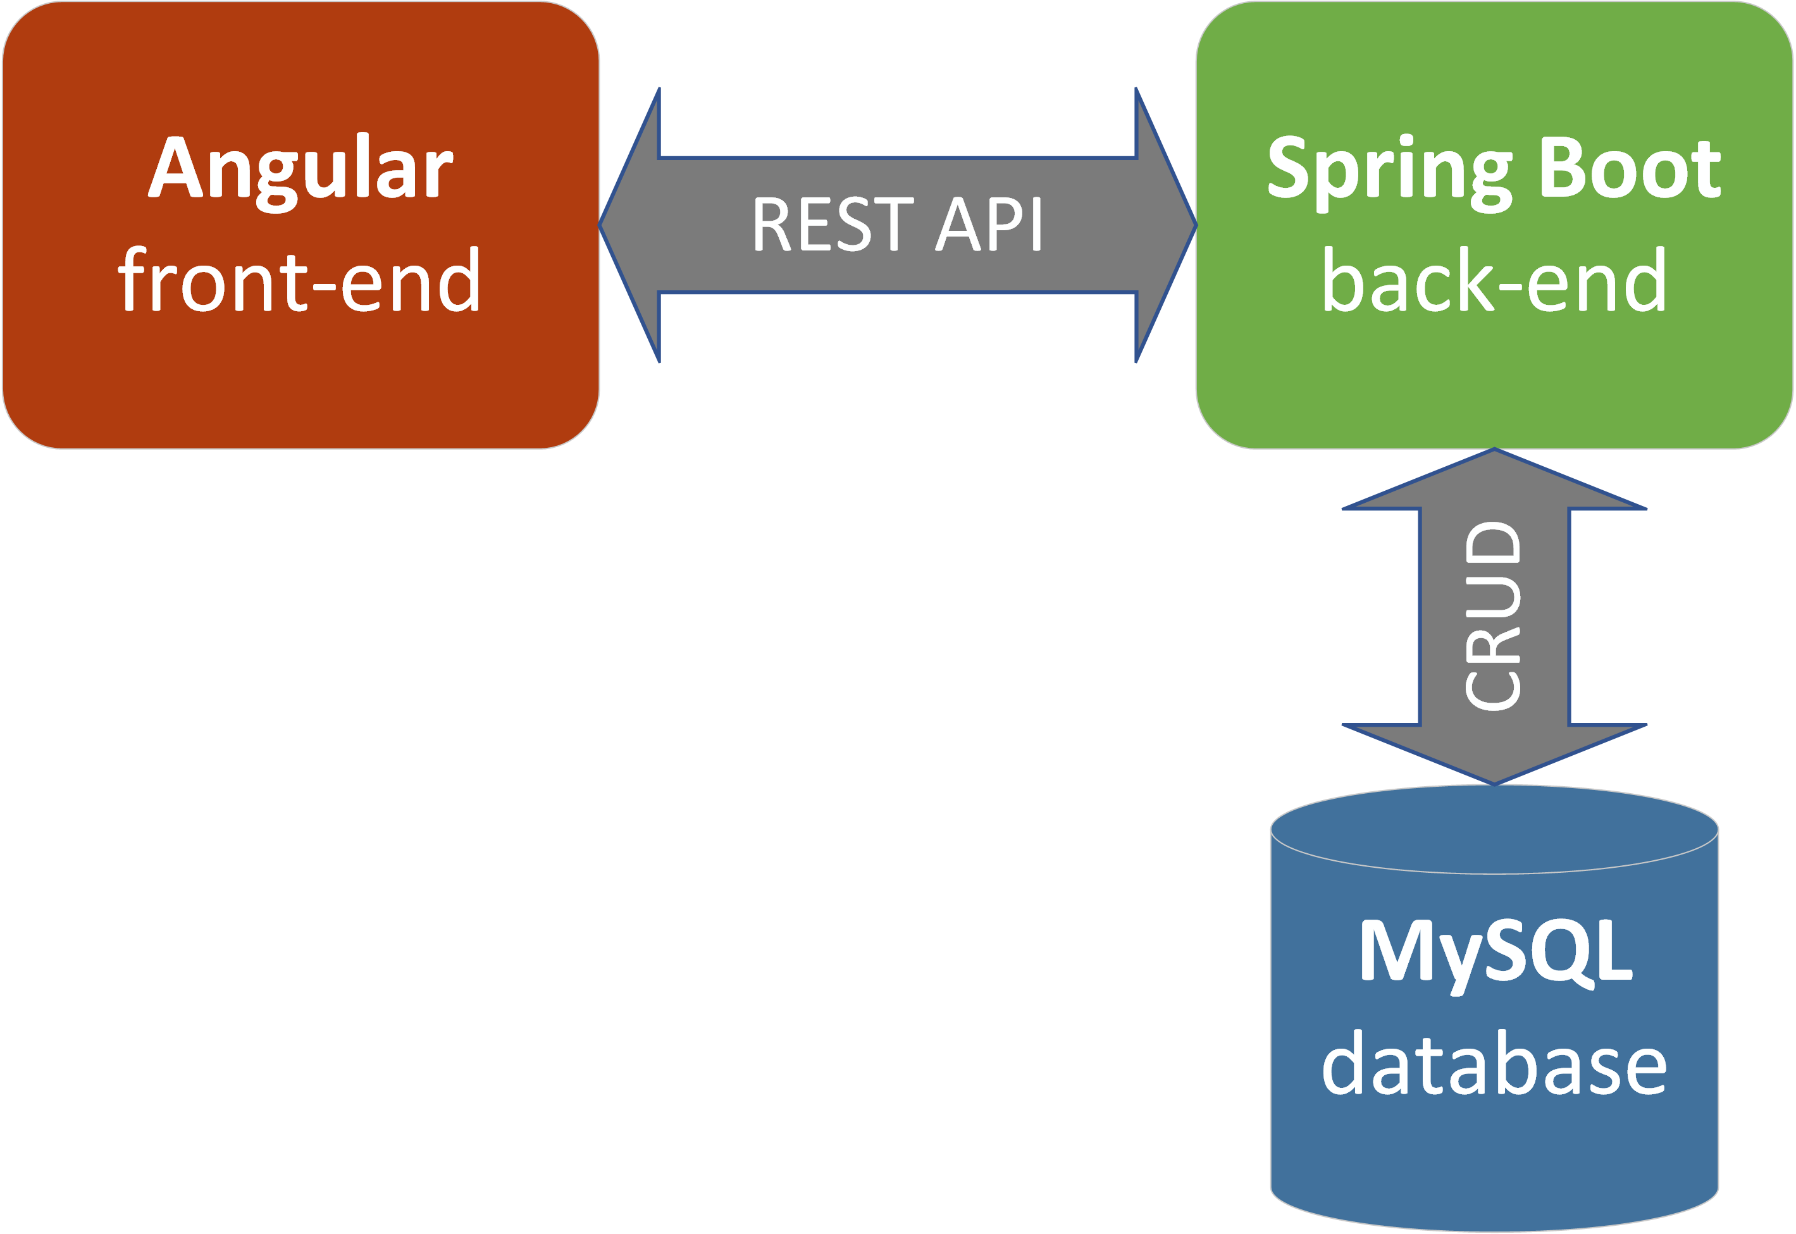
Application Architecture
san k at sankdev0@gmail.com

Slide 4
Credits
First slide: fragment of photo by Patrick Hendry on Unsplash.
General architecture follows advice from Full Stack: Angular and Java Spring Boot course on Udemy by Chad Darby (https://www.udemy.com/course/full-stack-angular-spring-boot-tutorial/). Highly recommended for beginner developers.

